Slide 1
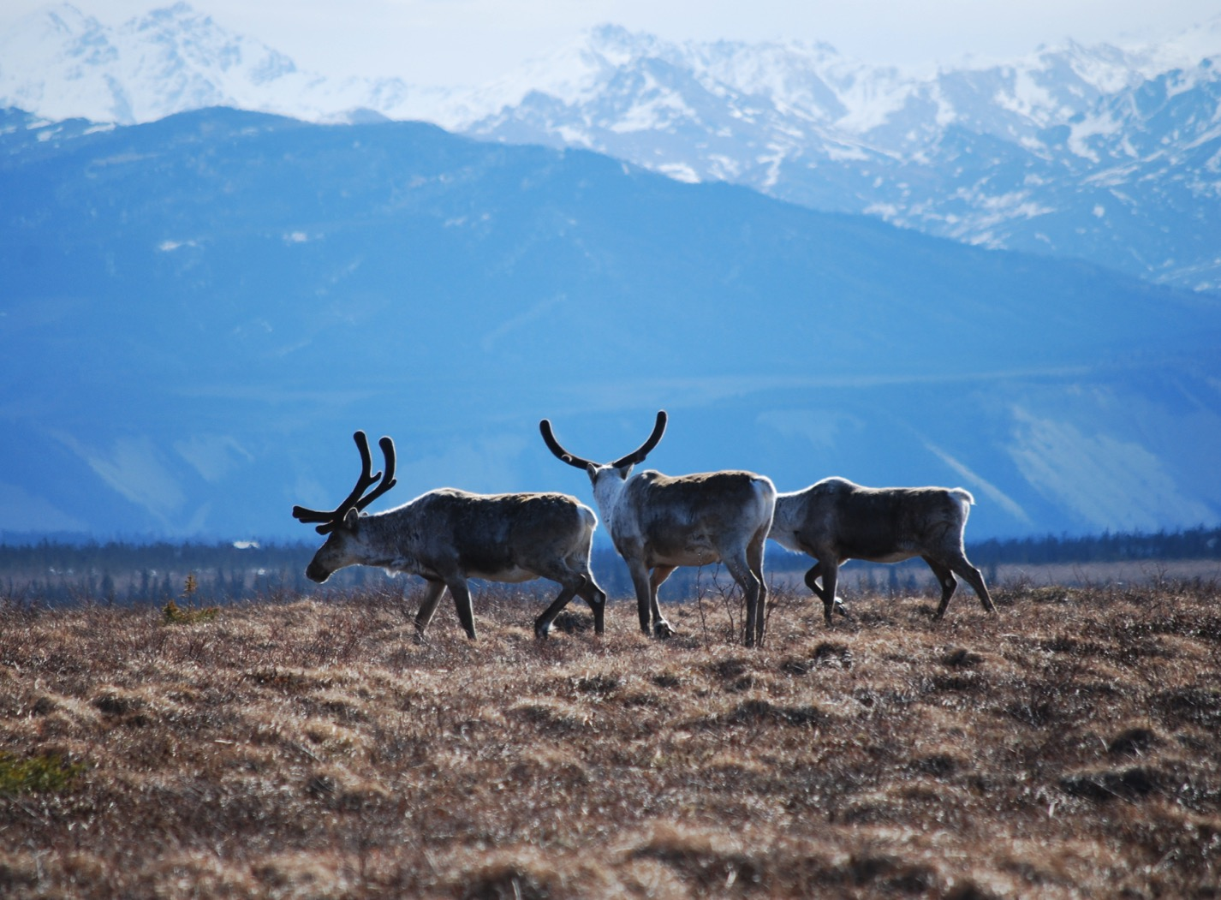
Arctic Boreal Vulnerability Experiment (ABoVE)
2017 ABoVE Airborne Campaign
16 June 2017 (DOY 167)
UAVSAR: Southwest Alaska
Charles Miller, Deputy Science Lead
Jet Propulsion Laboratory, California Institute of Technology
and the ABoVE Science Team For Hank Margolis, Eric Kasichke, Bruce Tagg
NASA HQ
2017

Slide 2
16 June 2017/DOY 167 Southwest Alaska
Daily Summary:
C-20A (N30502) UAVSAR ABoVE CAMPAIGN (CANADA / ALASKA)
REPORT DATE: 16 June 2017
Current Status of Aircraft: GREEN
Current Status of SAR: GREEN
Current Status of PPA: GREEN
Current Deployment Location: Fairbanks, Alaska (PAFA)
Crew: Asher, Barry, Griffith, Choi, T Miller
Science Coordinator: N Pinto
Science Lead: M Moghaddam
Project Manager: Y Lou

Slide 3
16 June 2017/DOY 167 Southwest Alaska
Daily Summary:
Science Flight (PAFA – PAFA #1) – 5.9 hours
Good flight
Collected 6 complete lines and 2 partial lines (#1 & #5) of the 8 data lines
Line #1: restricted air space prevented the collection of the entire line (flown in manual mode)
Line #5: the radar stopped transmitting near the end of the line
Both to be re-flown 6/17/17 on YK Delta flight plan
Central & Southwest Alaska, BNZ, Denali, Delta Junction
Flight Plan – 1140v02

Slide 4
16 June 2017/DOY 167 72-Hour Look Ahead
All plans weather dependent
Saturday 17 June 2017 (DOY 168):
Yukon-Kuskokwim Delta
Sunday 18 June 2017 (DOY 169):
Hard down day
Monday 19 June 2017 (DOY 170):
Seward Peninsula

Slide 5
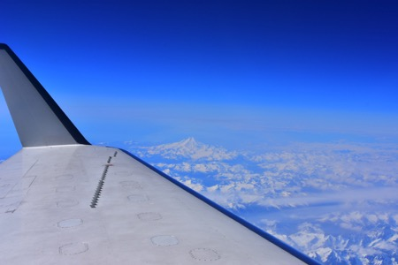
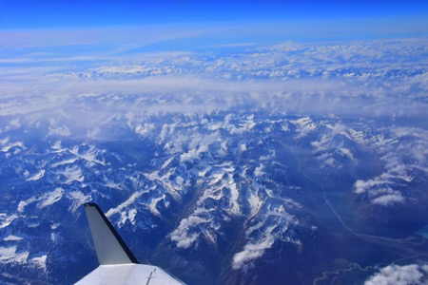
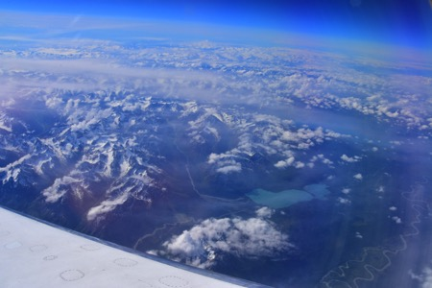
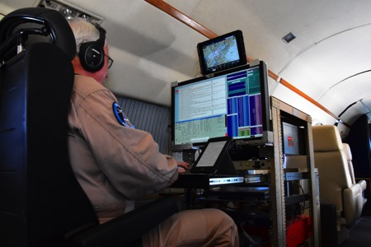
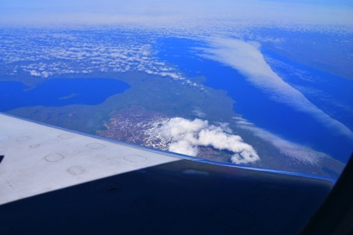
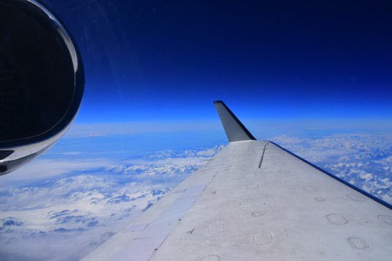
16 June 2017/DOY 167 Southwest Alaska
Stevens Village
Beaver
Kotzebue
Notes:
https://www.youtube.com/watch?v=aPVLyB0Yc6I

Slide 6
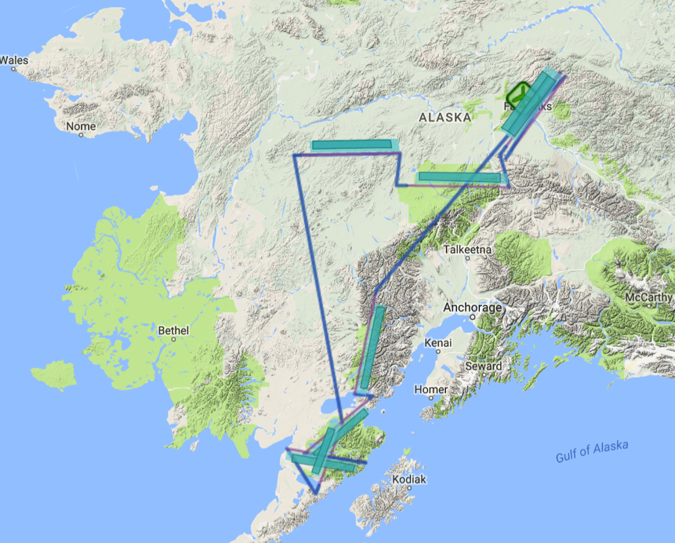
16 June 2017/DOY 167 Southwest Alaska
Flight Plan 1140 v02, Report 17065: Fairbanks AK (PAFA) – PAFA
https://uavsar.jpl.nasa.gov/cgi-bin/report.pl?planID=PLAN_17065#flightPlan
6/16/17 flight plan & acquisition segments
Data Acquisitions:
Line 1, ID 19205: LClark
Line 2, ID 23004: Katmai 1
Line 3, ID 28020: Katmai 2
Line 4, ID 02112: Katmai 3
Line 5, ID 08911: Poorman
Line 6, ID 09114: Denali
Line 7, ID 03603: BNZ LTER 1
Line 8, ID 03604: BNZ LTER 2
03603
03604
08911
09114
19205
23004
28020
02112
Notes:
PLAN_1140_v02. Changes to V1: matched lines to P-band lines in 1121_v01.

Slide 7
16 June 2017/DOY 167 Southwest Alaska
UAVSAR Quick-look products
A. Line 1, ID 19205: LClark (incomplete acquisition)
B. Line 2, ID 23004: Katmai 1
C. Line 3, ID 28020: Katmai 2
Joanne Shimada, JPL
A
B
C
Notes:
Rugged terrain and wide inlets characterize these lines. Soil moisture and vegetation ground truth sites from the National Parks Service Southwest Alaska Network (SWAN) are located throughout this region

Slide 8
16 June 2017/DOY 167 Southwest Alaska
UAVSAR Quick-look products
A. Line 4, ID 02112: Katmai 3
B. Line 5, ID 08911: Poorman (failed)
C. Line 6, ID 09114: Denali
Joanne Shimada, JPL
A
B
C
Notes:
A. Another line sampling SWAN ground truth sites
Line failed during multiple acquisition attempts
This line covers multiple ground truth site clusters in Denali National Park

Slide 9
16 June 2017/DOY 167 Southwest Alaska
UAVSAR Quick-look products
A. Line 7, ID 03603: BNZ LTER 1
B. Line 8, ID 03604: BNZ LTER 2
Joanne Shimada, JPL
A
B
These lines cover the upland forest, fen, bog and flood plain areas of the NSF Bonanza Creek Long-term Ecological Research site southwest of Fairbanks along the Tanana River
Notes:
A&B: these lines support multiple teams looking at the impact of the 2015 fires on tundra, carbon fluxes and wildlife. Ground penetrating radar measurements will be acquired over select ground sites here
C. UAVSAR imagery will help characterize coastal weltands and critical waterfowl areas of the YK Delta

